Slide 1
ProtoType Design pattern
Presented by :- Vinay
Teammates :- Abhiram,Satyanvesh

Slide 2
Introduction
Prototype design pattern is one of the creational design pattern.
‘Cloning’ of an existing object instead of creating new one and can also be customized as per the requirement.

Slide 3
WHY ?
This pattern should be followed ,
When a Object Creation is a costly affair and requires a lot of time and resources and you have a similar object already existing.

Slide 4
Steps
we create interface with the method of getclone();
We declare getclone() by implementing the interface in a class(override).
we set the data or fetch from database and store it.
we will copy the object and give some functionality.

Slide 5
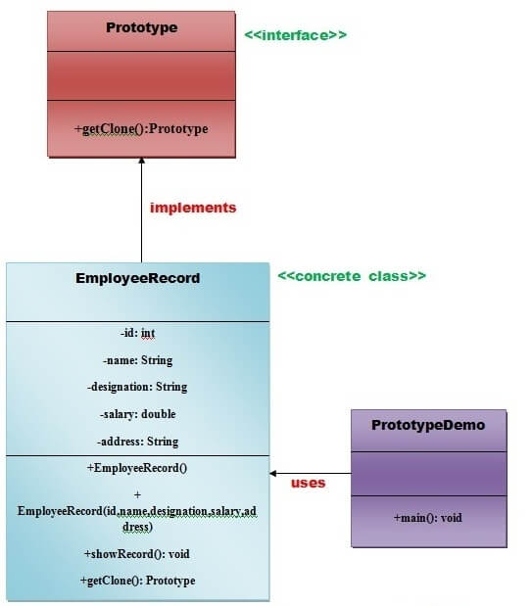
Flow

Slide 6
Advantages
It reduces the need of sub-classing.
It hides complexities of creating objects
It lets you add or remove object at runtime.

Slide 7
The End

